Slide 1
ANALYTICS ASSESSMENT
- PRIYAVARSHANA BR

Slide 2
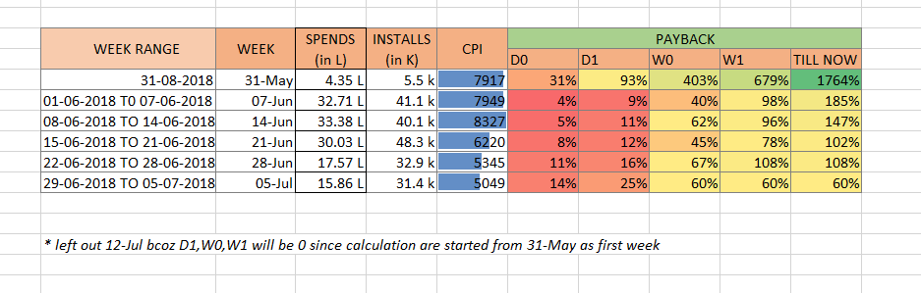
QUES 1 - Week on Week overall spends vs. payback % within Day 0 of install, Day 1 of install, Week 1 of install, W2 of install & overall payback. Payback is basically the Return on Investment

Slide 3
QUES2 - Which TG & which Ad Type is giving the best payback in Week
TG Ad type
WEEK-1 Purchasers LA Testimonial(F)
WEEK-2 Purchasers LA Testimonial(F)
WEEK-3 Middle East Testimonial(M)
WEEK-4 US+APAC Transformations
WEEK-5 Middle East Testimonial(M)
WEEK-6 Purchasers LA Testimonial(M)

Slide 4
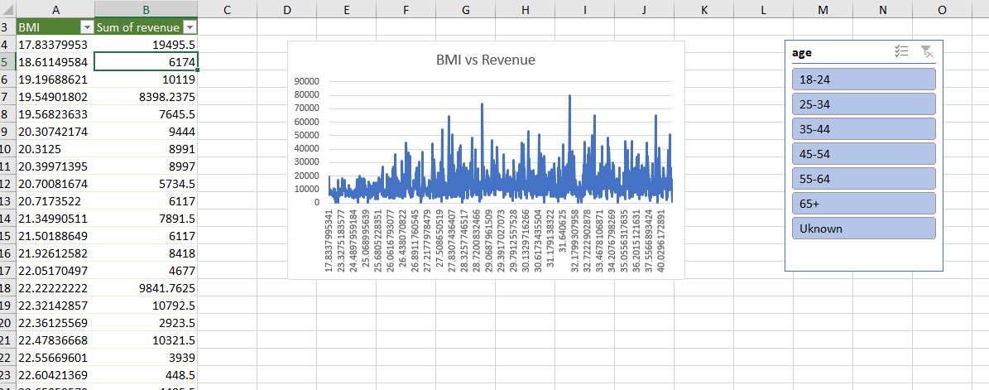
QUES 3 - What's the Age & BMI distribution of the revenue.

Slide 5
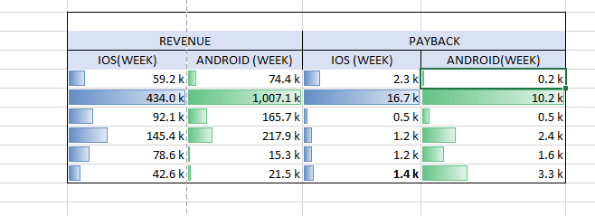
QUES 4 - iOS Vs. Android comparison of revenue and payback within Week 1 of install
* (weekly analysis)

Slide 6
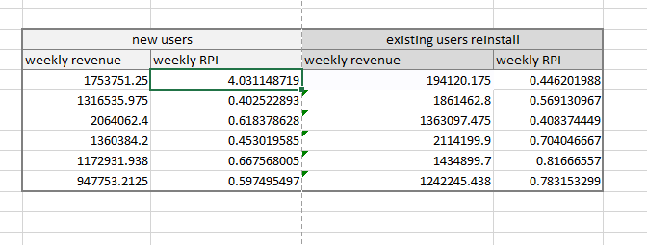
QUES5 - How much net revenue is coming from new installs Vs. existing users reinstalls and their respective Day 7 RPI (defined as the Revenue from a particular audience segment within 7 Days (<=7) of Install Date divided by the amount spent to get those installs).`

